Slide 1

Rockbuster Stealth Data Analysis
By Angus Berry

Slide 2

What do we need to know to optimise the launch strategy of Rockbuster’s new online video service?

Slide 3


THE STORY SO FAR…
958 Titles
14,596 Rentals
599 Customers
108 Countries Worldwide
$61,312.04 Revenue
 | Rental Rate | Rental Duration | Rental Replacement | Film Length (minutes)
Minimum | $0.99 | 3 days | $9.99 | 46
Maximum | $4.99 | 7 days | $29.99 | 185
Average | $2.98 | 4.985 days | $19.984 | 115.272

Slide 4
Which ratings contributed most to revenue?

Slide 5
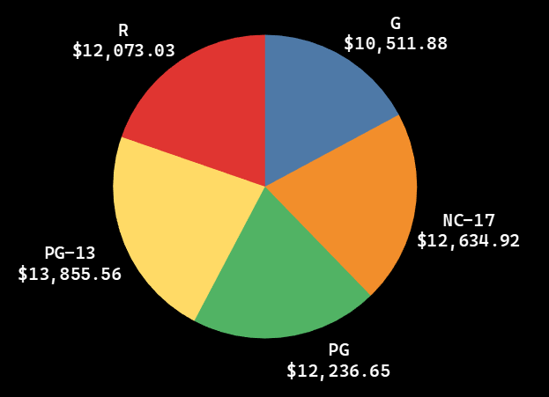
Revenue by Rating
PG-13 is most common and has produced the highest revenue.
G is the least common and has the lowest revenue.
PG is the most successful for revenue per title.
Rating | No. of titles | Revenue per title
PG-13 | 213 | $65.05
NC-17 | 202 | $62.55
R | 189 | $63.88
PG | 183 | $66.87
G | 171 | $61.47

Slide 6
Which genres are the most popular?

Slide 7
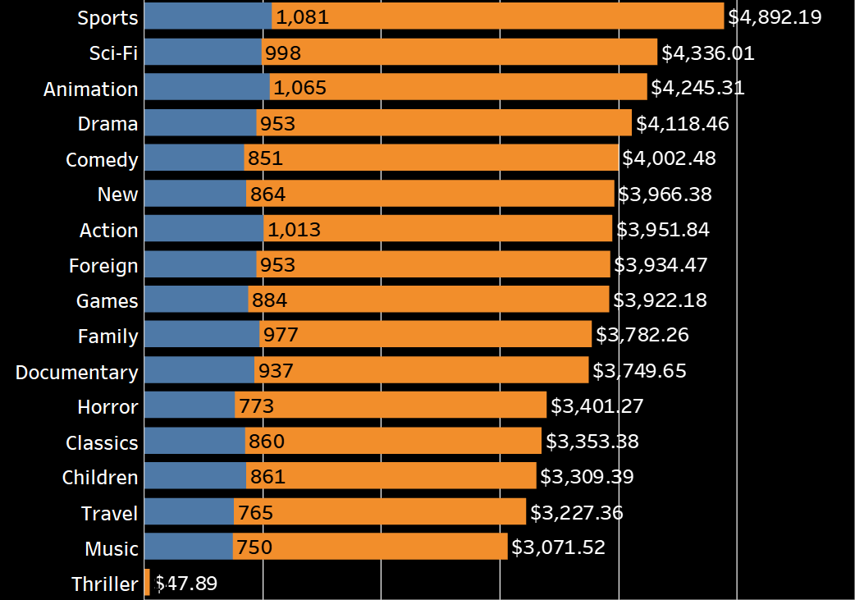

Revenue by Genre
Genre (Top 3) | Revenue per Rental
1. Comedy | $4.70
2. New | $4.59
3. Sports | $4.53
Genre (Bottom 3) | Revenue per Rental
15. Classics | $3.90
16. Family | $3.87
17. Children | $3.84
Comedy is best performing genre per rental.
Children is worst performing genre per rental.
Higher number of rentals does not necessarily mean higher revenue.

Slide 8
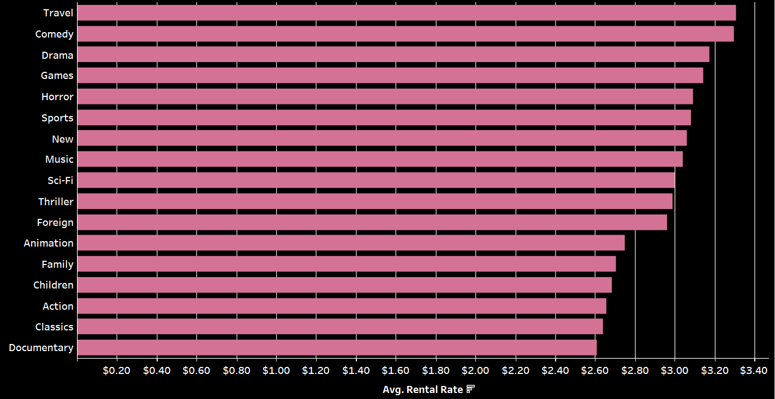
Average Rental Rates by Genre
Average Rental Rate : $2.98
Comedy, sports and new genres performing above average.
There are also no apparent correlations between rental rates and number of total rentals.
Interesting to note, travel titles have the highest average rental rate, but one of the lowest total rentals.
Animation also ranks quite low on average rentals but highly on total rentals.

Slide 9
Which countries are our customers based in?

Slide 10
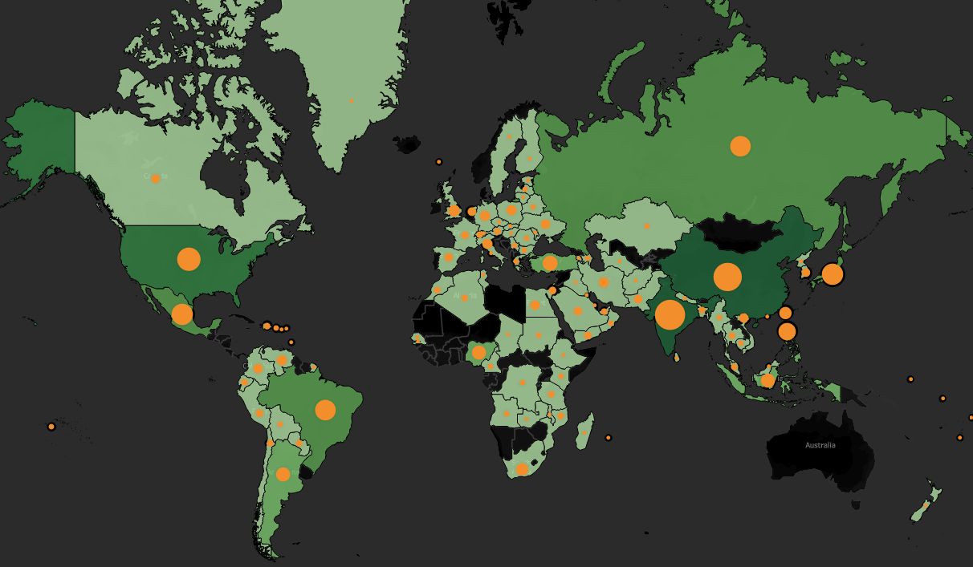
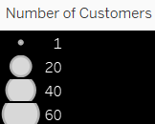
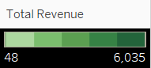
Sales Figures by Region
Country | Customers | Revenue
1. India | 60 | $6,035
2. China | 53 | $5,251
3. USA | 36 | $3,685
4. Japan | 31 | $3,123
5. Mexico | 30 | $2,985
Higher volume of customers in India, South-East Asia and North America
Lower volume of customers and revenue in Europe, particularly Western Europe.
No customers at all in Australia and large parts of Africa.

Slide 11
Where are our high lifetime value customers from?

Slide 12
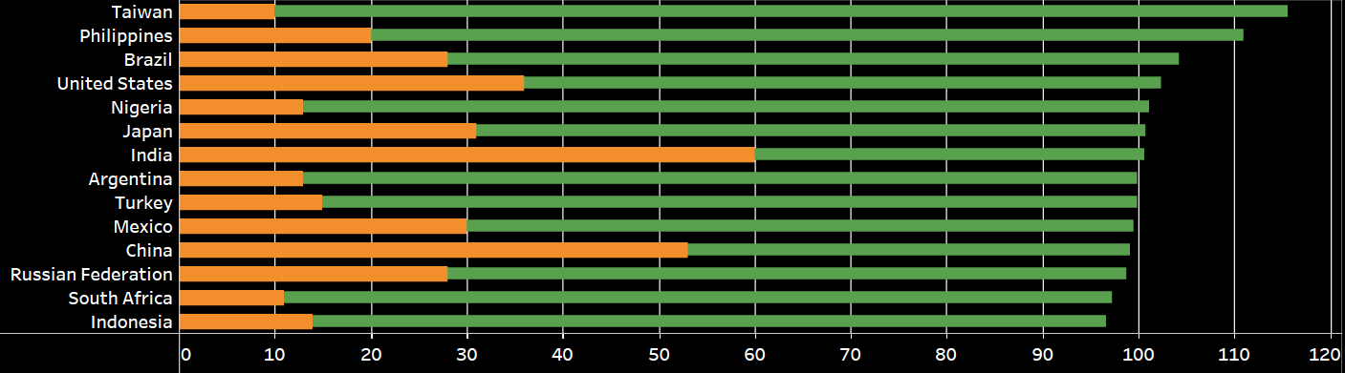
High Value Customers (countries with 10 or more customers)
AVERAGE CUSTOMER VALUE = $102.40
Customer | Country | Total Spend
1. Eleanor Hunt | Reunion | $211.60
2. Karl Seal | USA | $208.60
3. Marion Snyder | Brazil | $194.60
4. Rhonda Kennedy | Netherlands | $191.60
5. Clara Shaw | Belarus | £189.60
Taiwan, Philippines and Brazil are the top 3 countries for average customer value.
South Africa and Indonesia have a significantly lower average customer value.

Slide 13



Best and Worst Performing Titles
Telegraph Voyage - $215.75
Zorro Ark - $199.72
Wife Turn - $198.73
Innocent Usual - $191.74
Hustler Party - $190.78
Saturday Lambs - $190.74
Titans Jerk - $186.73
Harry Idaho - $177.73
Torque Bound - $169.76
Dogma Family - $168.72
Duffel Apocalypse - $5.94
Oklahoma Jumanji - $5.94
Texas Watch - $5.94
Freedom Cleopatra - $5.95
Rebel Airport - $6.93
Young Language - $6.93
Cruelty Unforgiven - $6.94
Treatment Jekyll - $6.94
Lights Deer - $7.93
Stallion Sundance - $7.94
AVERAGE TITLE REVENUE - $64

Slide 14

More PG and PG-13 rated titles.
Comedy, New and Sports genres perform better for revenue.
When marketing for new customers, focus on countries with higher average value.
Opportunity in African and Australian markets not yet achieved.
Promote best performing titles and look to remove those that are returning below average revenue.

Slide 15

Thank you!
Please let me know if you have any questions
Tableau Link : Rockbuster Presentation Viz - Angus Berry | Tableau Public
This Photo by Unknown Author is licensed under CC BY-NC-ND

